Slide 1
A QUICK LOOK AT MACHINE LEARNING using PYTHON
INT213

Slide 2
“Field of study that gives computers the ability to learn without being explicitly programmed”
--American electrical engineer and computer scientist
Arthur Samuel

Slide 3
Humans learn things in two ways—
  memorization and generalization.
  We use memorization to accumulate individual facts.
    For example, primary school students might learn a list of English words.
  Humans use generalization to deduce new facts from old facts.
    A student of political science, for example, might observe the behavior of a large number of politicians and
    generalize to conclude that all politicians are likely to make decisions intended to enhance their chances of staying in office.

Slide 4
When computer scientists speak about machine learning, they most often mean the field of writing programs that automatically learn to make useful inferences from implicit patterns in data.
In general, machine learning involves observing a set of examples that represent incomplete information about some statistical phenomenon, and then attempting to infer something about the process that generated those examples.
The examples are frequently called training data.

Slide 5

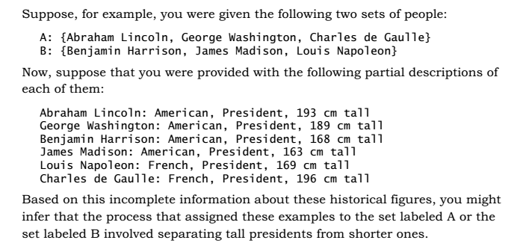
Feature vector example

Slide 6
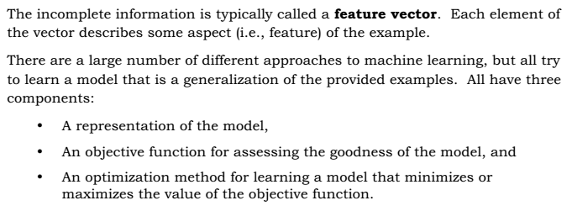
Feature Vector

Slide 7
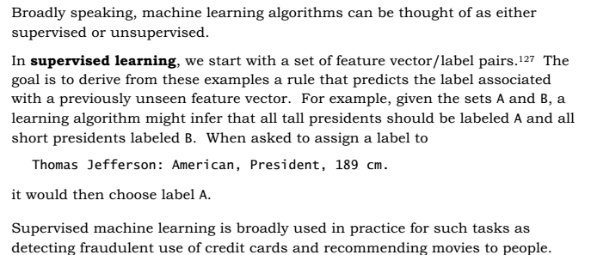
Supervised learning

Slide 8
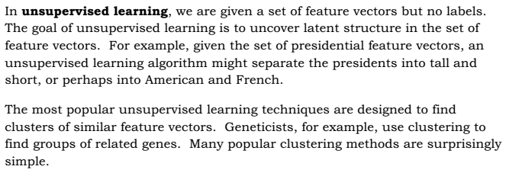
Unsupervised learning

Slide 9

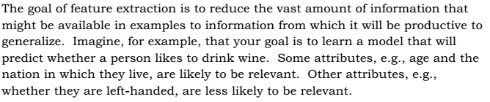
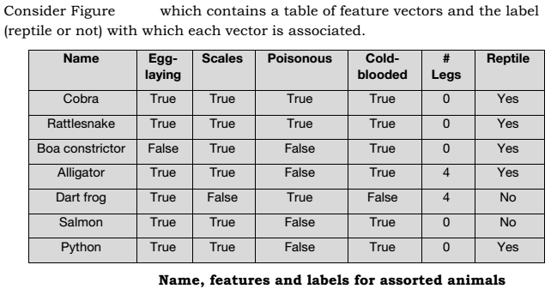

Slide 10

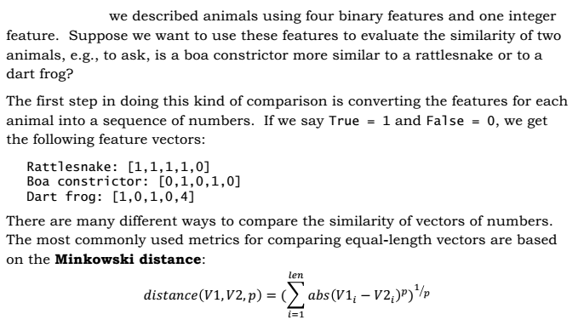

Slide 11
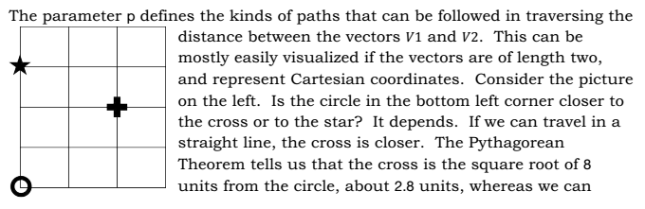
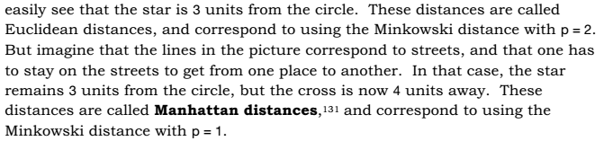
Euclidean distance vs Manhattan

Slide 12

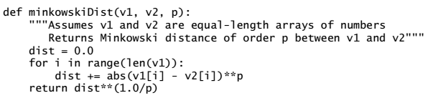

Slide 13
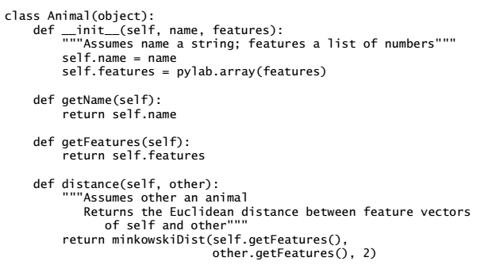
Class animal example

Slide 14
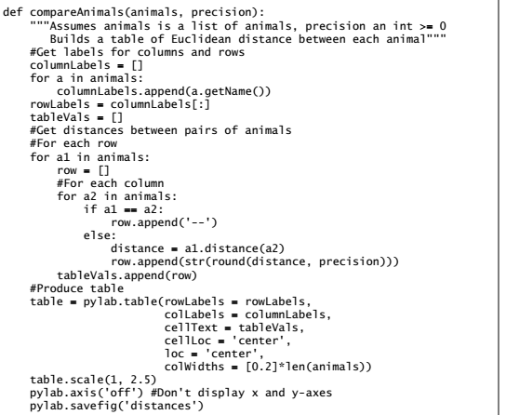

Slide 15
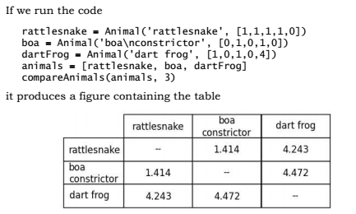
Example

Slide 16
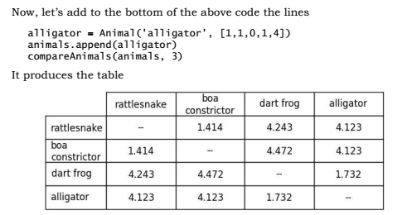
Example

Slide 17
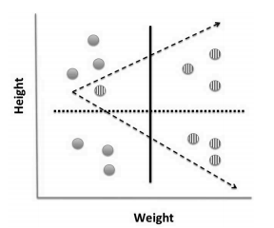
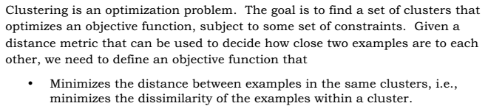

Slide 18
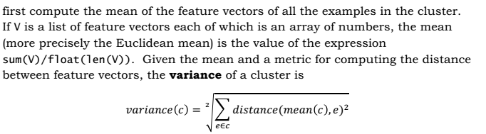
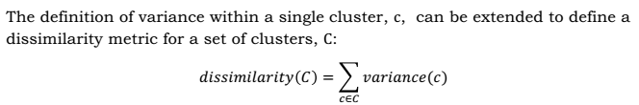
Dissimilarity

Slide 19
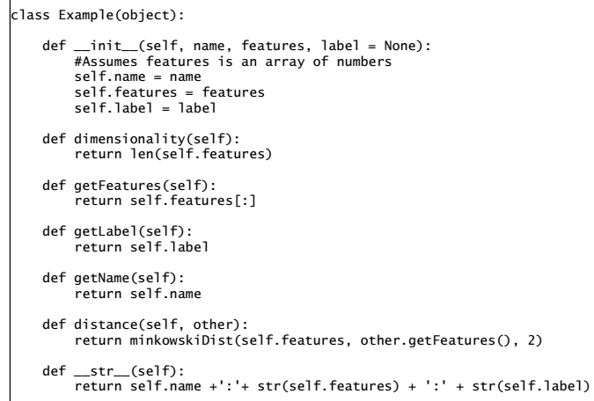
example

Slide 20
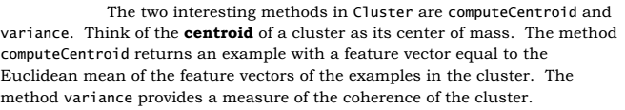
Class Cluster

Slide 21
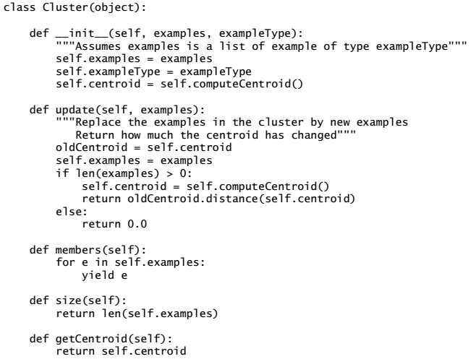

Slide 22
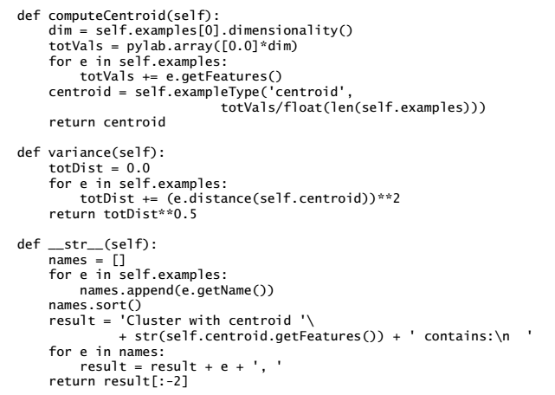

Slide 23

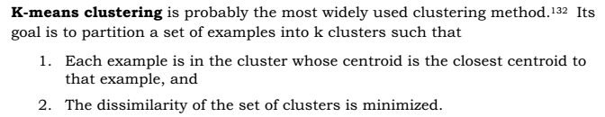
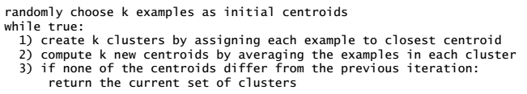

Slide 24


